Slide 1
Introduction to Python Packages, NumPy Fancy Indexing & Masking

Slide 2
What is a Package?
A module is usually a single Python .py file containing reusable code. A package groups related modules so that they can be organised and imported together.
Standard Library and Third-Party Packages: Python includes a large standard library of modules and packages. Third-party packages can be installed using tools such as pip.

Slide 3
Why Use Packages?
Modularity: Packages help break down large programs into smaller, manageable modules.
Reusability: Code can be reused across different programs by importing modules from packages.
Namespace Management: Packages help avoid naming conflicts by organising code into separate namespaces.

Slide 4


Creating a Custom Python Package
Open the Word document “Creating custom package”. It provides a step-by-step approach to creating a custom package on a Windows computer. It assumes you have already installed Windows Subsystem for Linux (WSL). (If you already have Linux, you can skip its installation)
Note: In modern Python __init__.py is not strictly required for every package, because namespace packages exist.
Create a Directory: Create a directory that will contain your package modules.
Add an __init__.py File: For a conventional Python package, add an __init__.py file to the package directory. The file may be empty or may contain package initialisation code.
Add Modules: Create Python files (modules) inside the directory. Each file can contain related functions and classes.
Use the Package: Import the package or specific modules in your Python script and use the functionality provided.
my_package/
__init__.py
calculations.py

Slide 5
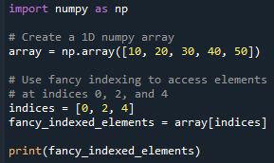
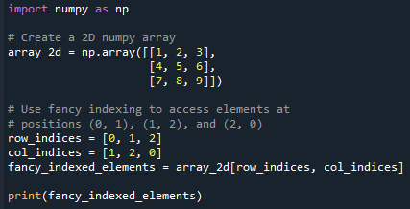
Fancy Indexing
Fancy indexing involves using arrays (or lists) of integers to index another array (passing an array of indices to access multiple array elements at once.) This can be very useful when you need to access multiple non-contiguous elements or specific patterns within an array.
Allows you to create new arrays by specifying the exact indices of the elements you want to extract.
Fancy indexing allows you to access and manipulate elements based on complex criteria that would be difficult to achieve with regular slicing.
You can select multiple, non-contiguous elements from an array, which is useful for various advanced operations.
One-dimensional output: [10, 30, 50]
Multi-dimensional arrays. Output: [2, 6, 7]

Slide 6
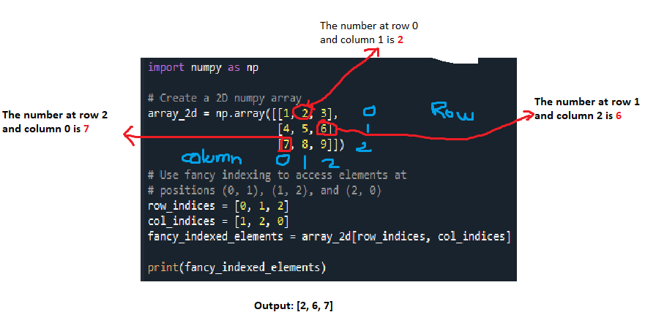
Fancy Indexing

Slide 7
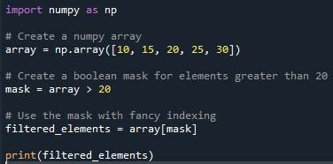
Practical Uses of Fancy Indexing
Selecting elements based on certain conditions.
Reordering or reshaping data.
Creating masks or filters to process specific parts of an array.
Fancy indexing is often used in conjunction with boolean arrays (masks) to select elements that meet specific conditions.
In this example, mask is a boolean array that is used to filter the elements of array that are greater than 20.
Output = [25, 30]

Slide 8
Masking in numpy
The practice of using boolean arrays to select elements of another array.
It is a boolean array that is the same shape as the original array, where each element is either True or False.
When you apply this mask to the original array, you retrieve elements that correspond to True values in the mask.
In brief, it allows to:
  Select elements of an array based on conditions.
  Modify elements that meet certain criteria.
  Combine multiple conditions to create complex masks.
Masking is commonly used in data analysis for:
  Filtering data based on conditions.
  Cleaning or modifying specific parts of a dataset.
  Performing computations on subsets of data.
  Visualizing specific data points in plots.

Slide 9
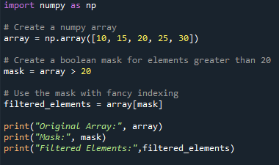

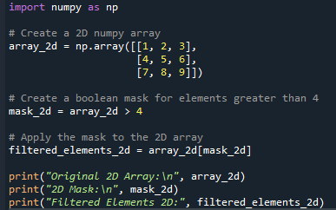
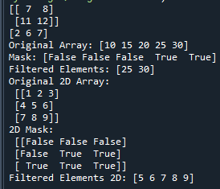
Masking in numpy
array > 20 creates a boolean mask where elements greater than 20 are marked as True.
Applying the mask array[mask] returns only the elements of array where the mask is True
array_2d > 4 creates a boolean mask for the 2D array.
Applying the mask array_2d[mask_2d] returns a 1D array containing elements of array_2d where the mask is True.

Slide 10
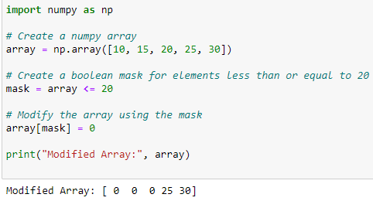
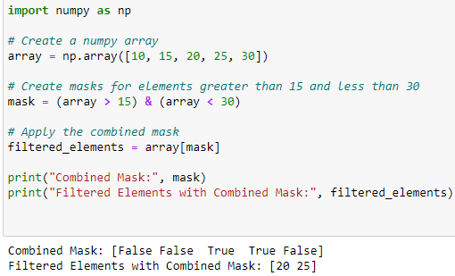
Modifying Arrays Using Masks
The mask array <= 20 identifies elements less than or equal to 20.
array[mask] = 0 sets those elements to 0.
The combined mask (array > 15) & (array < 30) selects elements that are greater than 15 and less than 30.
Applying the mask returns the elements [20, 25].

